Slide 1


AUTOMATIC
FAN
SPEED
CONTROLLER
USING
ARDUNIO
RMK COLLEGE OF ENGINEERING AND TECHNOLOGY
Done by
Maheshkumar G
Janardhanan J
Janarthanan B
Karthikeyan S

Slide 2

INTRODUCTION
Temperature controlling is required in many places such as server rooms, houses, industries, etc. So this project can be very useful in understanding the basics, how you can control the temperature at your home. You can take this as a DIY project which can be used anywhere. Here the Temperature controlled fan will act to the temperature changes.
We are going to do this with a DHT11 temperature and humidity sensor. It can be done in various other ways as well. With a thermistor or other sensors like a contactless temperature sensor. But thermistor usually needs contact of the surface and contactless sensors can be costly. While DHT11 is a cost-effective sensor.

Slide 3
INTRODUCTION
In this project, we are going to discuss making a temperature-controlled fan using Arduino.
With this circuit, we will be able to change the fan speed in our home or any place according to the room temperature and also display the temperature and fan speed changes on a 16x2 LCD display.
To do this we will be using an Arduino UNO Board, LCD, DHT11 sensor Module, and DC fan. Let's get started.

Slide 4
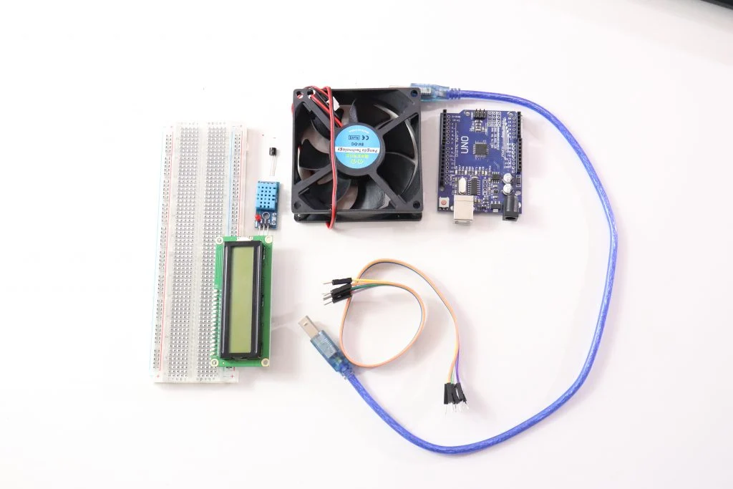
COMPONENTS REQUIRED
Ardunio UNO
USB A TO B
Breadboard
DHT11 Sensor
2n2222 Transistor
16x2 LCD
Connecting wires
Connections of this are very easy to do, here an LCD is connected for displaying temperature and Fan speed Status.

Slide 5
PROCEDURE
This project works in three parts -
STEP 1: Gather all these components
In the first step, the sensor senses the temperature by temperature and humidity sensor namely DHT11.
In the second step, the sensor's output is taken and conversion of temperature value into a suitable number in Celsius scale is done. The fan speed is controlled by using PWM signals. And last part of the system shows humidity and temperature on LCD and Fan runs.
Then we have programmed our Arduino according to the requirements. Working on this is very simple. We have generated PWM from Arduino and put it at the base terminal of the transistor. Then transistor generates voltage with respect to the PWM input.

Slide 6
PROCEDURE
STEP 2: LCD connection with Arduino
LCD is directly connected to Arduino (Check this tutorial for more details: LCD Interfacing with Arduino UNO). Connect pins of LCD- RS, EN, D4, D5, D6, and D7 to Arduino's digital pin numbers 7, 6, 5, 4, 3, and 2.
STEP 3: DHT 11 temperature and humidity sensor connection
And a DHT11 sensor module is also connected to digital pin 12 of Arduino. Digital pin 9 is used for controlling fan speed through the transistor.

Slide 7
PROCEDURE
STEP 4: Upload the code
The below section is for the code. Here the first table gives you an idea of what PWM value will be the speed of the fan. You can change values according to your need.
CODE:
Before writing the code, please refer to the below table.
Temperature | Duty Cycle | PWM Value | Fan Speed
Less than 26 | 0% | 0 | OFF
26 | 20% | 51 | 20%
27 | 40% | 102 | 40%
28 | 60% | 153 | 60%
29 | 80% | 204 | 80%
Greater than 29 | 100% | 255 | 100%

Slide 8
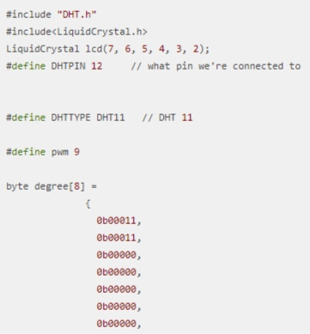
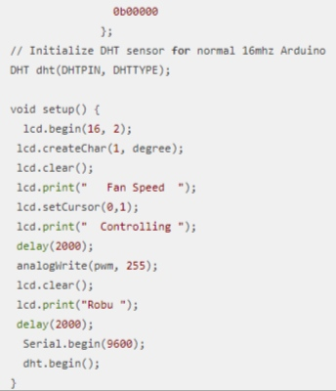
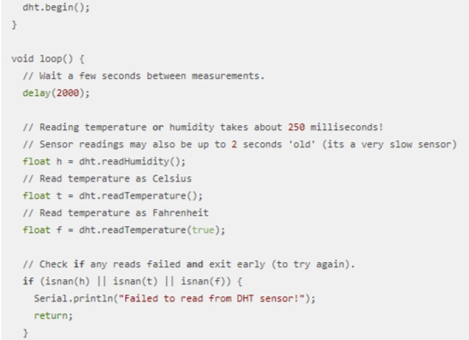
CODE

Slide 9
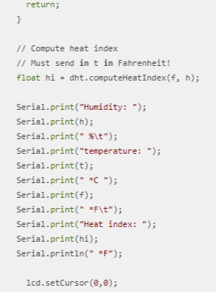
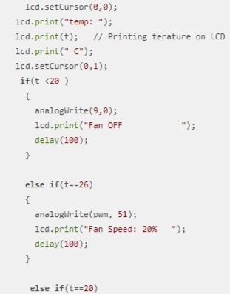
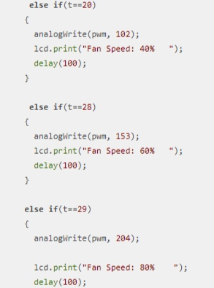
CODE

Slide 10
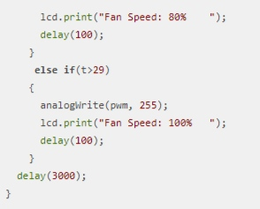
CODE
CONCLUSION
We can make a temperature-controlled fan circuit. Using an Arduino, DHT11, and few other components.Which can be used pretty much any place where temperature needs to be maintained at specific levels. Like in some industries, houses, etc. We checked how it actually works and we also learned how to code for a temperature-controlled fan.

Slide 11
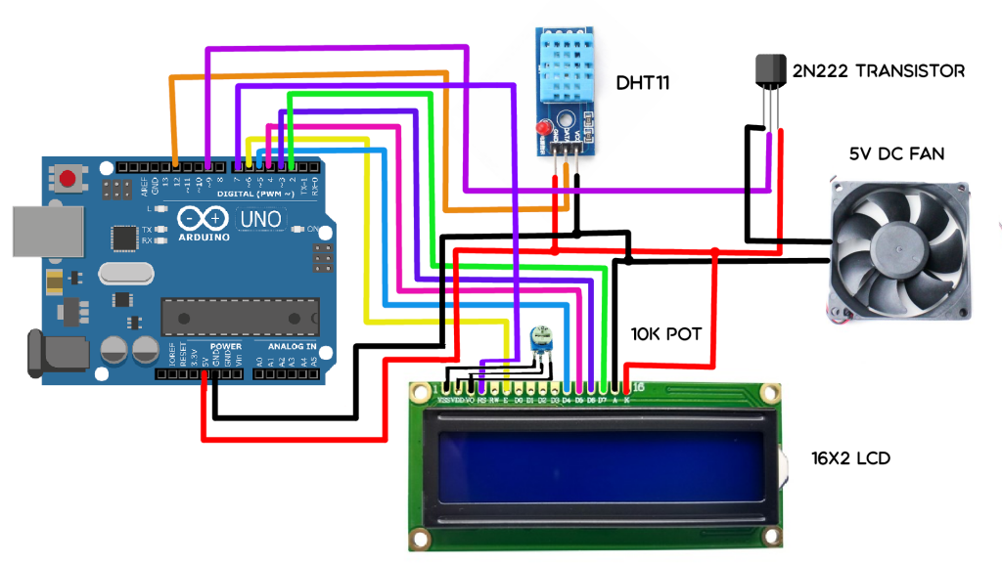
CIRCUIT DIAGRAM

Slide 12


